Slide 1
Economic Analysis
CO2 storage into oil reservoir

Slide 2
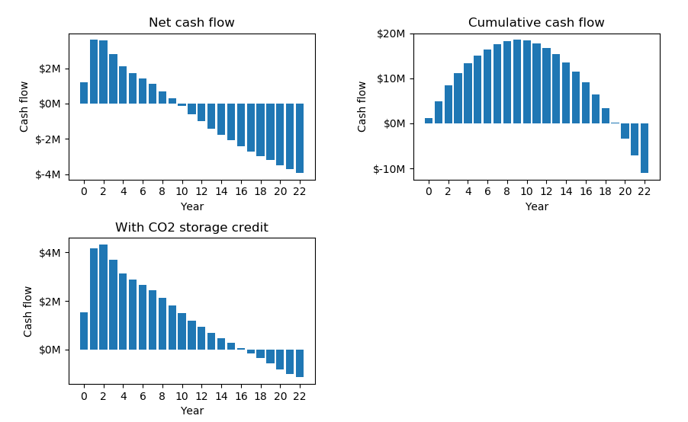
Cash flows
NPV: 3.43 $MM
NPV with CO2 storage credit: 25.14 $MM

Slide 3
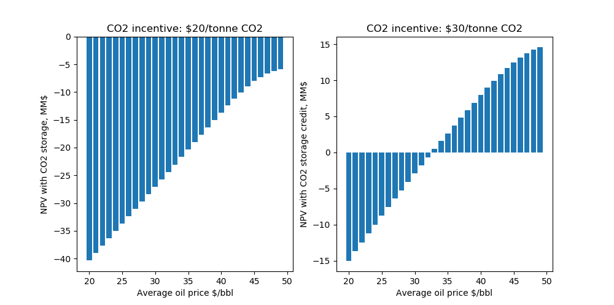
Sensitivity analysis

Slide 4
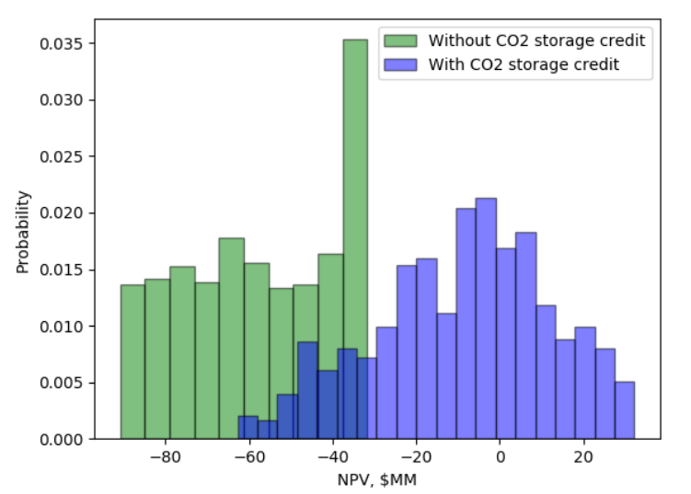
Uncertainty

